Slide 1
Monitorizarea Resurselor Azure
Cărăușan Bogdana
Lect. Sergiu-Adrian Dărăbant

Slide 2

Agenda

Slide 3

De ce?
Kibana
C
U
S
T
O
m
Elastic Search
Service fabric
CPU overload
Application Insights

Slide 4
Cum?

Slide 5
Retrieve metrics
You can access and explore metrics via the following:
Metric Definitions and Metrics REST APIs
Azure Portal preview.
Azure CLI commands.
.NET SDK.
Java SDK.
Grafana has also updated their Azure Monitor Plugin (version 0.1.0) to leverage these new APIs.

Slide 6
Transitions
Microsoft.WindowsAzure.Management.Monitoring last updated 1/30/2015
Microsoft.Azure.Management.Monitor 0.20 preview
Microsoft.Azure.Insights 0.15.0-preview
=> REST APIs

Slide 7
Metric Definitions
GET https://management.azure.com/{resourceUri}/providers/microsoft.insights/metricDefinitions?api-version=2018-01-01
"id": "/subscriptions/a329319b-9a69-4749-9a2a-c70db554f0a1/resourceGroups/smartMonitorDemoApp/providers/Microsoft.Web/sites/smartMonitorDemoApp/providers/microsoft.insights/metricdefinitions/CpuTime",
"resourceId": "/subscriptions/a329319b-9a69-4749-9a2a-c70db554f0a1/resourceGroups/smartMonitorDemoApp/providers/Microsoft.Web/sites/smartMonitorDemoApp",
"namespace": "Microsoft.Web/sites",
"name": {
"value": "CpuTime",
"localizedValue": "CPU Time"},
"unit": "Seconds",
"primaryAggregationType": "Total",
"metricAvailabilities": [
{"timeGrain": "PT1M",
"retention": "P93D”},
{"timeGrain": "PT5M",
"retention": "P93D" },
{"timeGrain": "PT15M",
"retention": "P93D"} …

Slide 8
Metrics
https://management.azure.com/subscriptions/*{subscription-id}*/resourceGroups/*{resource-group-name}*/providers/*{resource-provider-namespace}*/*{resource-type}*/*{resource-name}*/providers/microsoft.insights/metrics?metric=*{metric}*&timespan=*{starttime/endtime}*&$filter=*{filter}*&interval=*{timeGrain}*&aggregation=*{aggreation}*&api-version=*{apiVersion}*

Slide 9
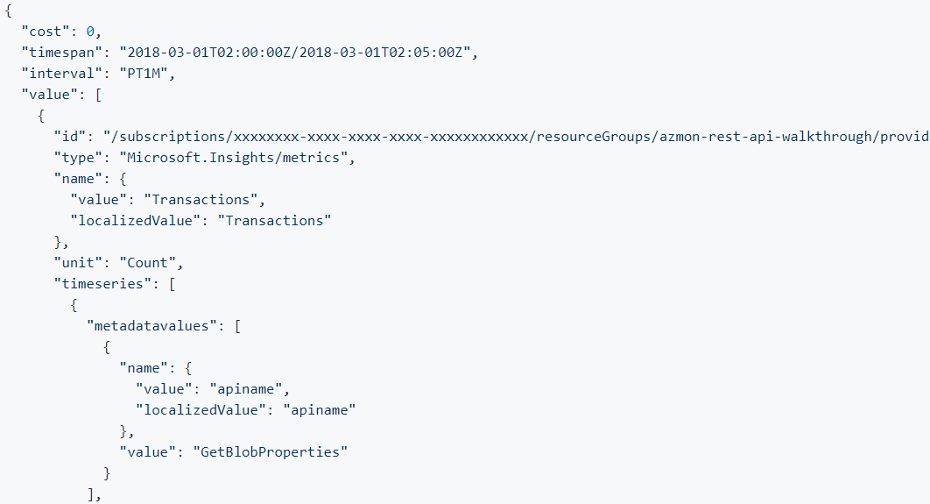
Metric details

Slide 10
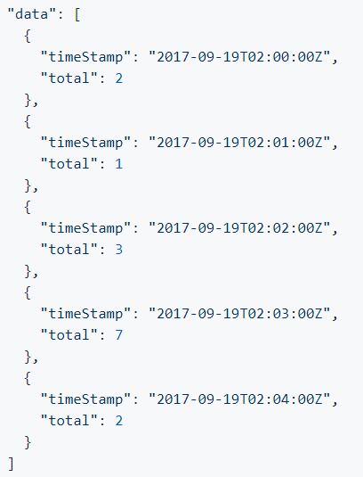
Metric data

Slide 11
Ce?

Slide 12
Virtual Machines
Key metrics:
CPU percentage – determine how utilized your processors are
Disk I/O - how your applications are impacting your hardware, and vice versa.
Disk Read
Disk Write
Memory metrics – to identify low-memory conditions and performance bottlenecks.
Network metrics - available in bytes per second or via the number of TCP segments sent and received

Slide 13
Websites
Average Response Time
The average time taken for the app to serve requests in ms.
Average memory working set
The average amount of memory in MiBs used by the app.
CPU Time
The amount of CPU in seconds consumed by the app
Data In
The amount of incoming bandwidth consumed by the app in MiBs.
Data Out
The amount of outgoing bandwidth consumed by the app in MiBs.
Http 2xx, 3xx, 4xx
Count of requests resulting in an HTTP status code
Http Server Errors
Count of requests resulting in an HTTP status code >= 500 but < 600.
Memory working set
Current amount of memory used by the app in MiBs.
Requests
Total number of requests regardless of their resulting HTTP status code.

Slide 14
Storage Accounts
Metric | Metric Display Name | Unit | Aggregation Type | Description | Dimensions
UsedCapacity | Used capacity | Bytes | Average | Account used capacity | No Dimensions
Transactions | Transactions | Count | Total | The number of requests made to a storage service or the specified API operation. | ResponseType, GeoType, ApiName
Ingress | Ingress | Bytes | Total | The amount of ingress data, in bytes. | GeoType, ApiName
Egress | Egress | Bytes | Total | The amount of egress data, in bytes. | GeoType, ApiName
SuccessServerLatency | Success Server Latency | Milliseconds | Average | The average latency used by Azure Storage to process a successful request, in milliseconds | GeoType, ApiName
SuccessE2ELatency | Success E2E Latency | Milliseconds | Average | The average end-to-end latency of successful requests made to a storage service or the specified API operation, in milliseconds. | GeoType, ApiName
Availability | Availability | Percent | Average | The percentage of availability for the storage service or the specified API operation. | GeoType, ApiNa

Slide 15
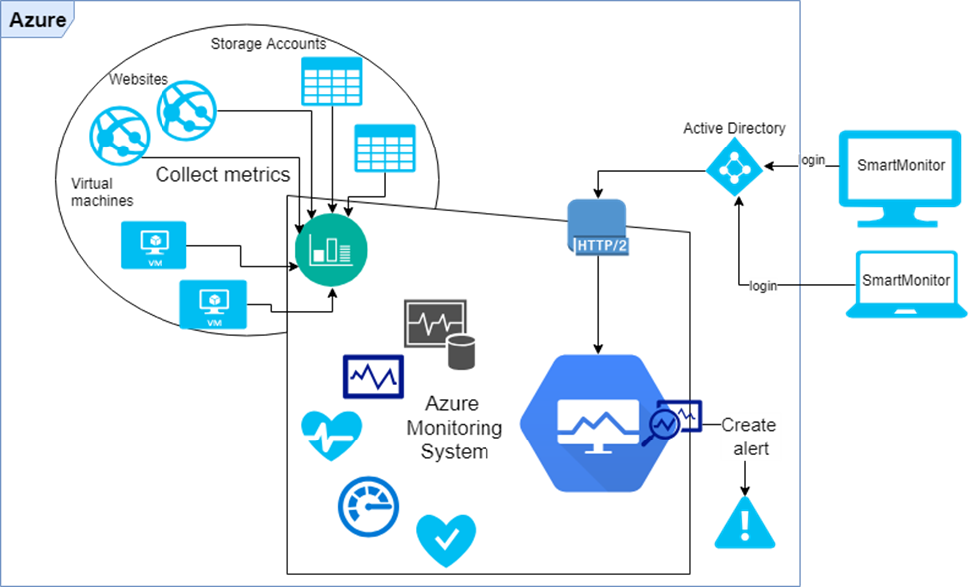
Architectural diagram

Slide 16

DEMO

Slide 17

Mulțumesc

